Slide 1

Programming and Data Visualization for Researchers for PSY3035 & HEL8048
Workshop 9
James McCutcheon
IPS / Helsefak

Slide 2
More about data visualisation
The content of this short lecture is based extensively on Fundamentals of Data Visualization by Claus O Wilke, which is freely available online
  https://clauswilke.com/dataviz/
I strongly recommend that everybody takes the time to read through the whole book. It is well-written, beautifully presented and not too long.

Slide 3
Directory of Visualizations
Amounts
Distributions
Proportions
x-y relationships
Geospatial data
Uncertainty

Slide 4
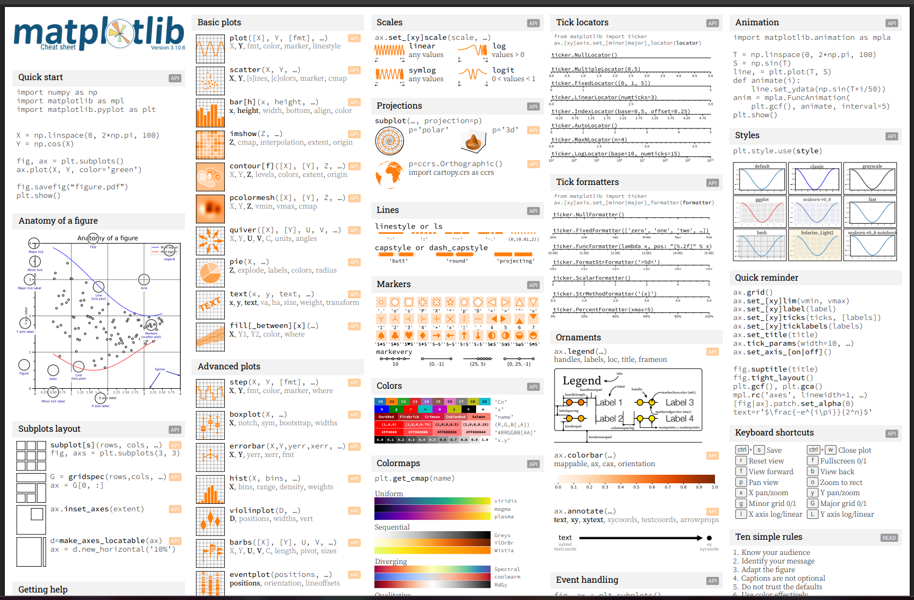
Directory of Visualizations
Amounts
Distributions
Proportions
x-y relationships
Geospatial data
Uncertainty

Slide 5
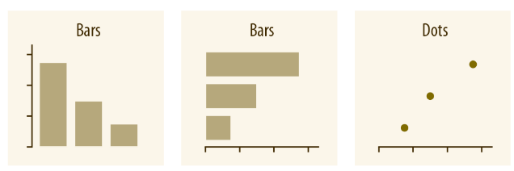
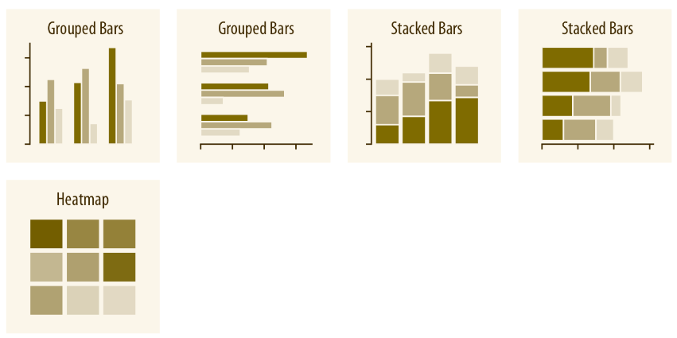
Amounts

Slide 6
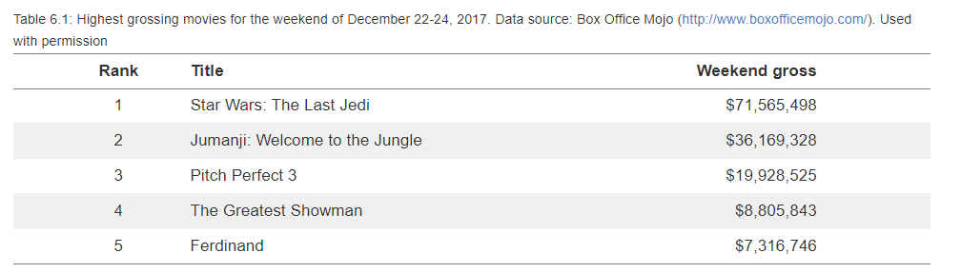
Amounts

Slide 7
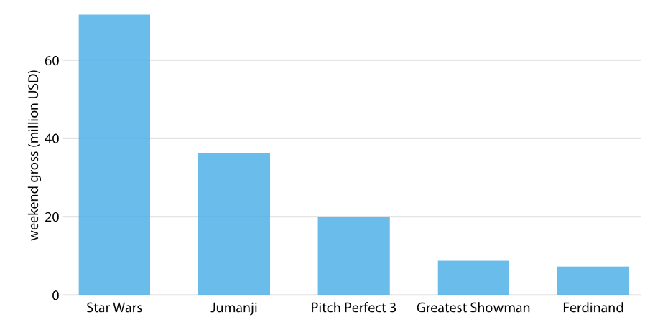
Bar charts
Labels are a little cramped and difficult to read

Slide 8
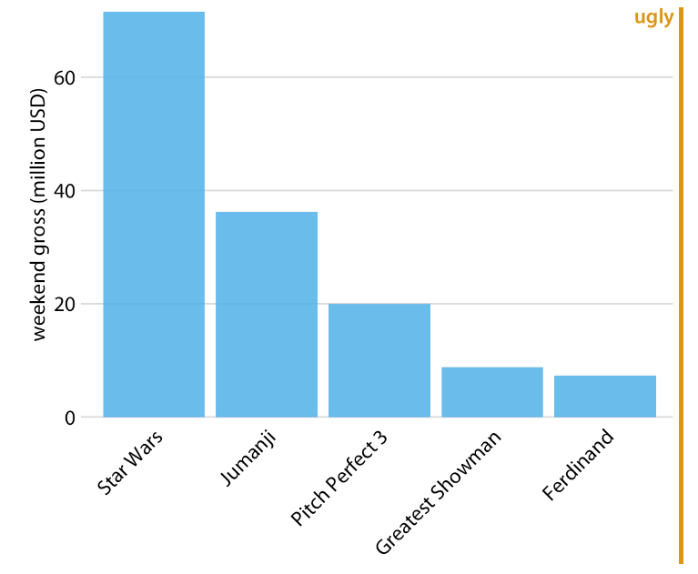
Bar charts
Rotated labels don’t make it that much better – space not used very efficiently and still a little difficult to read

Slide 9
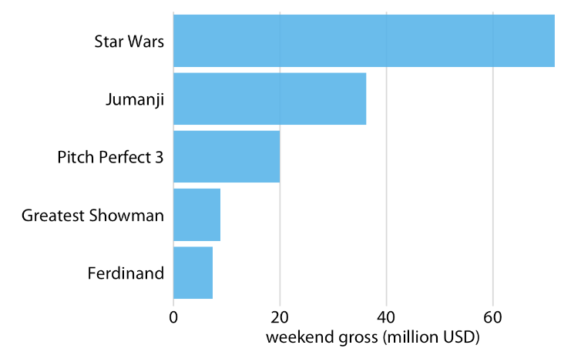
Bar charts
Horizontal bar chart is, in this case, given the number of bars and labels a lot clearer and more aesthetically pleasing
https://matplotlib.org/stable/api/_as_gen/matplotlib.pyplot.bar.html
https://matplotlib.org/stable/api/_as_gen/matplotlib.pyplot.barh.html

Slide 10
Amounts

Slide 11


The principle of proportional ink

Slide 12
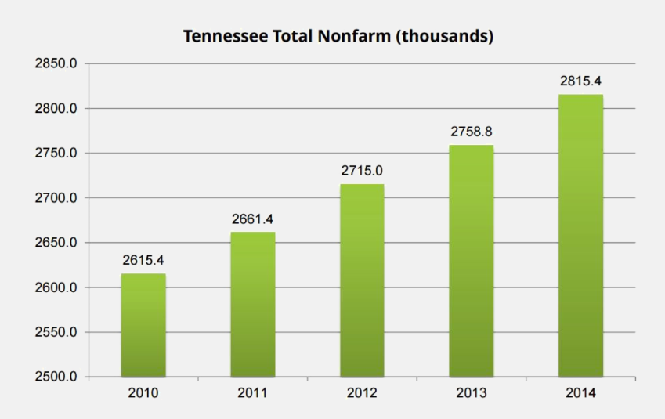
The principle of proportional ink

Slide 13
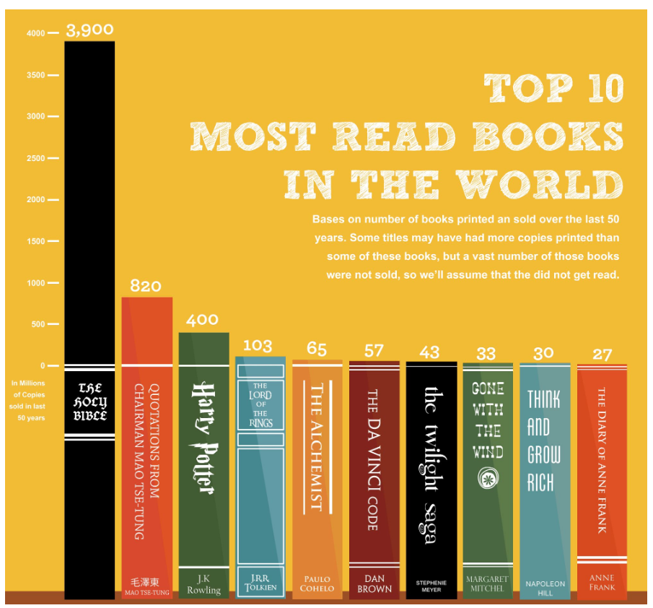

Slide 14
The principle of proportional ink
The consequence of this principle is that the axis on a bar chart should extend to zero…
…but on a dot plot or line chart it is acceptable to change the axis to display the data better

Slide 15
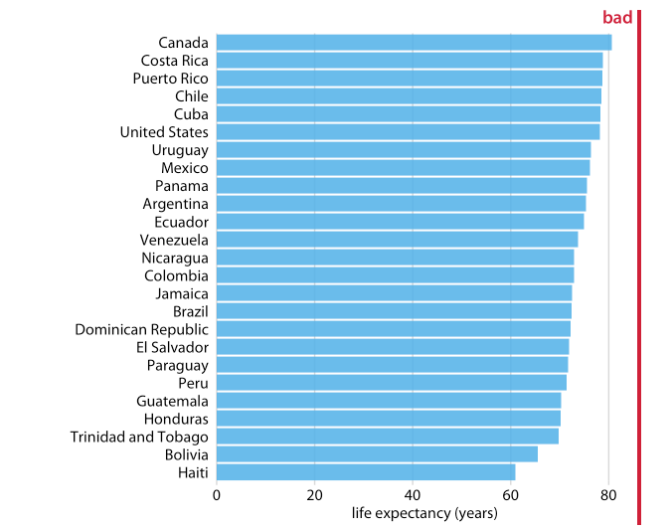
Dot plots

Slide 16
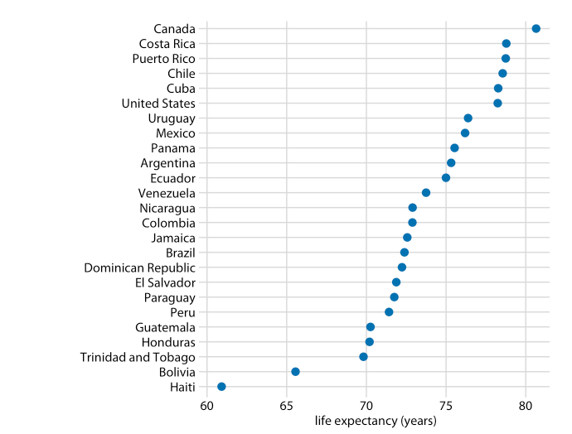
Dot plots

Slide 17
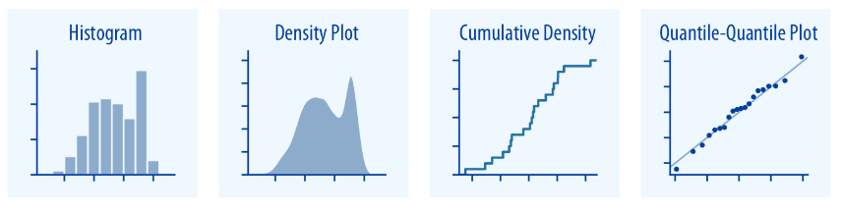
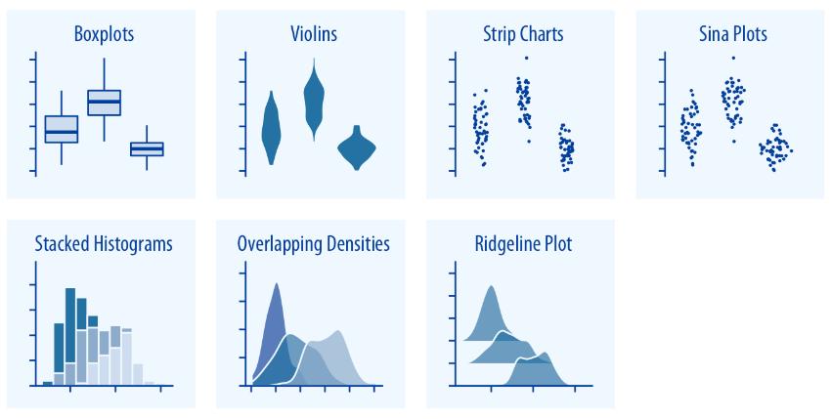
Distributions

Slide 18
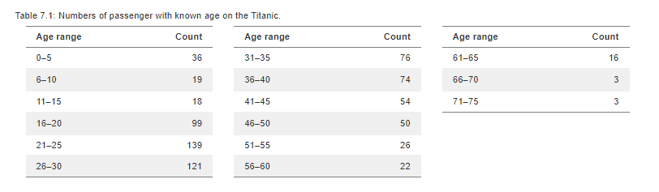
Histograms
Passenger # | Age (years)
1 | 34
2 | 67
3 | 51
4 | 22
5 | 3
6 | 35
7 | 32
8 | 11
9 | 27
….
756 | 24
To visualize a distribution, we can bin the data and plot the count (aka frequency) within each bin

Slide 19
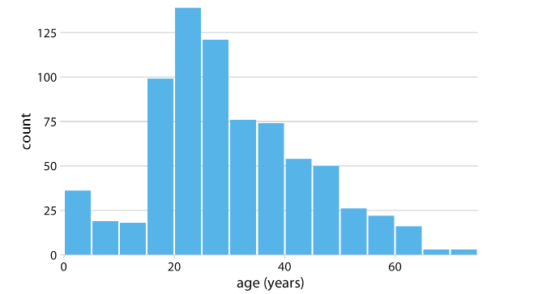
Histograms
The appearance of a histogram is critically dependent on bin width chosen…

Slide 20
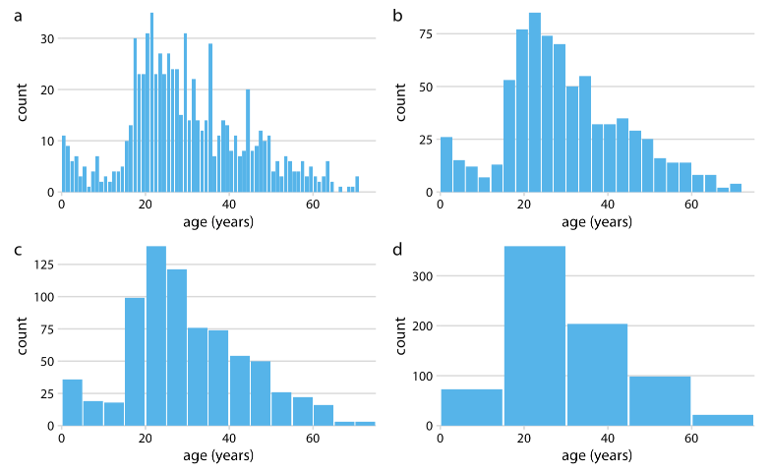
Histograms
The appearance of a histogram is critically dependent on bin width chosen…

Slide 21
Distributions

Slide 22
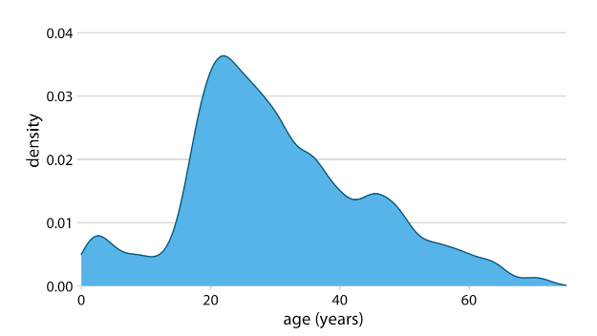
Density plots
Similar to a histogram but produce a smooth curve
Depend on the kernel and bandwidth rather than the bin size

Slide 23
Density plots
…a pitfall of density plots is that they can give the appearance of data where there is none by extending the tails of the distribution

Slide 24
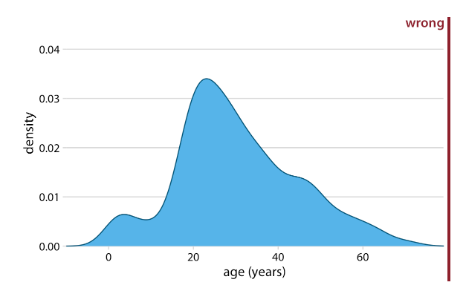
Density plots
…a pitfall of density plots is that they can give the appearance of data where there is none by extending the tails of the distribution

Slide 25
Distributions

Slide 26
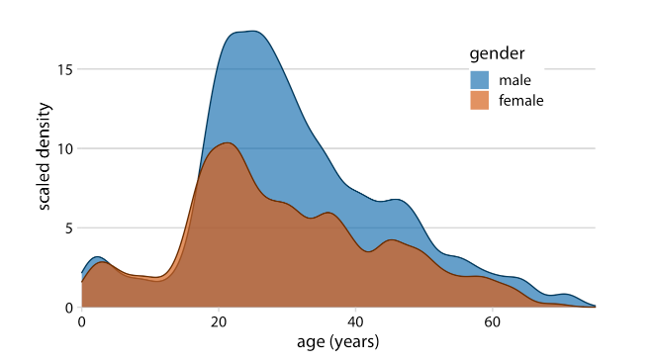
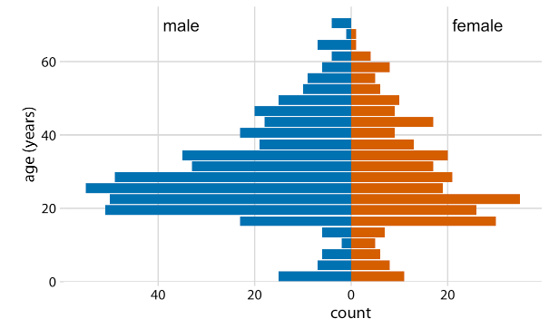
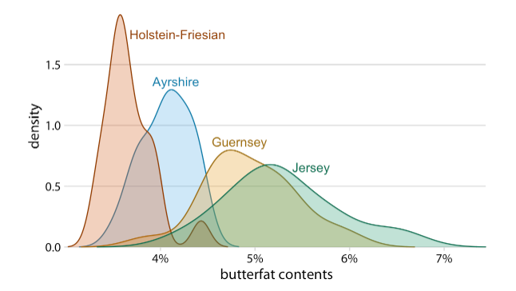
Visualizing multiple distributions
  Overlapping density plots
  Age pyramid
  Overlapping density plots with transparency

Slide 27
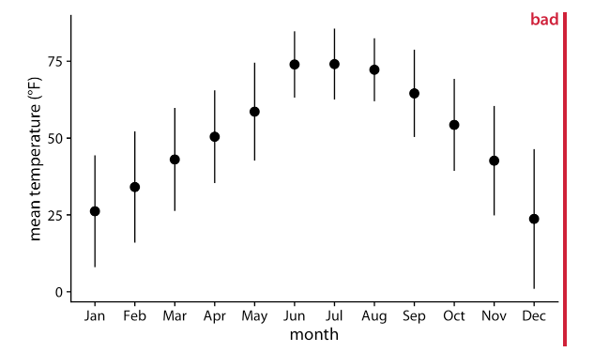
Visualizing multiple distributions
  Labelled “bad” because error bars traditionally show a measure of uncertainty, not variability

Slide 28
Distributions

Slide 29
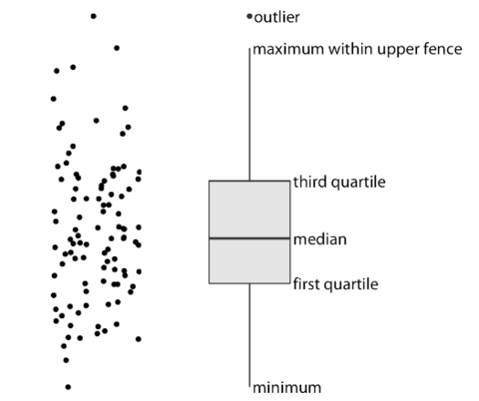
Visualizing multiple distributions
  Boxplots show more data about an underlying distribution

Slide 30
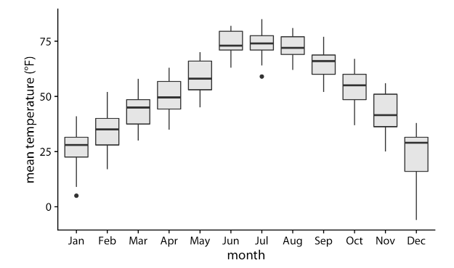
Visualizing multiple distributions
  Boxplots show more data about an underlying distribution
  Can be used to view many distributions at once
  However, not good at showing all nuances of data, for example, biomodal distributions

Slide 31
Distributions

Slide 32
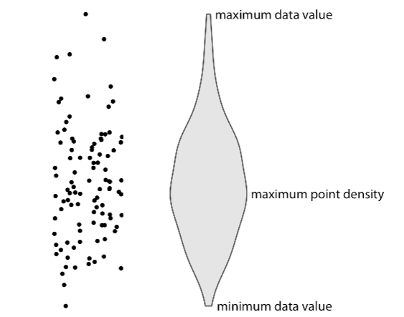
Visualizing multiple distributions
  Violin plots are basically a density plot that has been rotated and mirrored

Slide 33
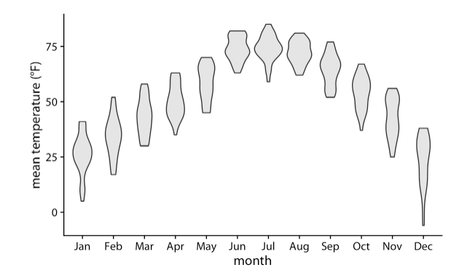
Visualizing multiple distributions
  Violin plots are basically a density plot that has been rotated and mirrored
  An effective way of showing multiple distributions but important to remember same caveats as with density plot – visualization should stop at the end of the range

Slide 34
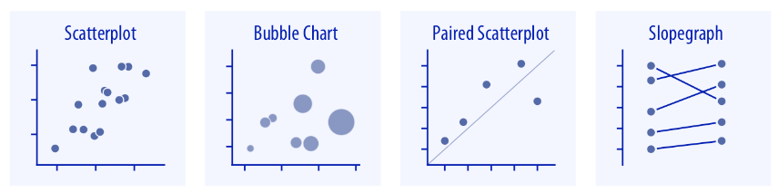
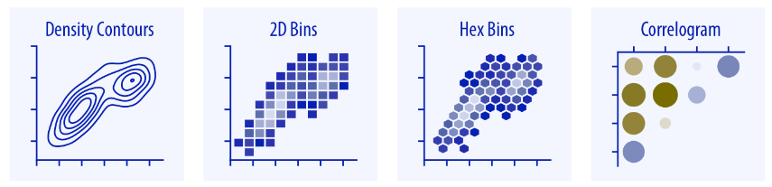
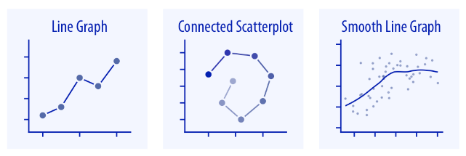
x-y relationships

Slide 35
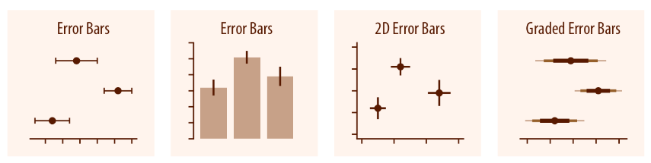
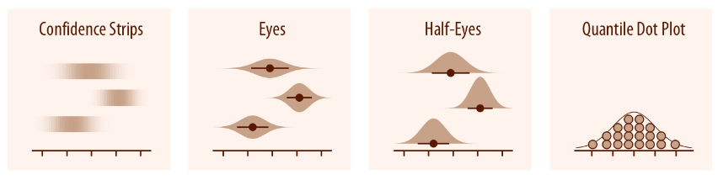
Uncertainty
  How we represent uncertainty might depend on the intended audience
  Scientific audiences might understand something about the statistics behind uncertainty whereas a lay audience probably does not

Slide 36
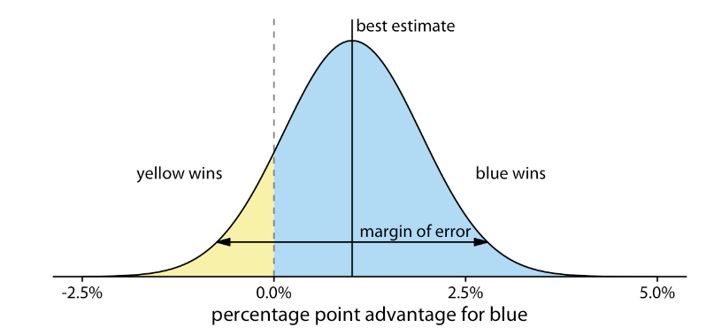
Uncertainty
  How can we show the probability of yellow winning in a way that is easier for human perception to interpret?

Slide 37
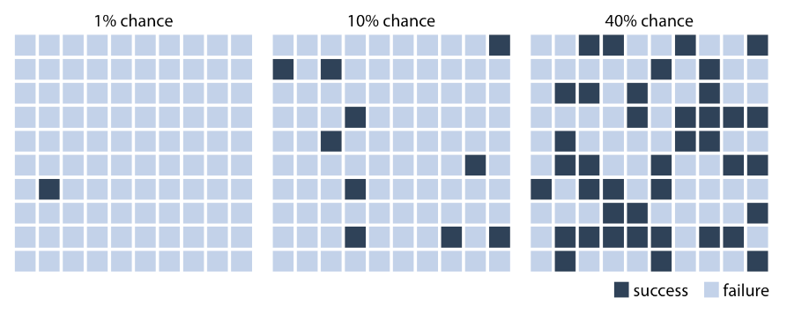
Uncertainty
  This is an example of discrete outcome visualization and showing probability as a frequency is known as frequency framing

Slide 38
Uncertainty
  How can we show the probability of yellow winning in a way that is easier for human perception to interpret?

Slide 39
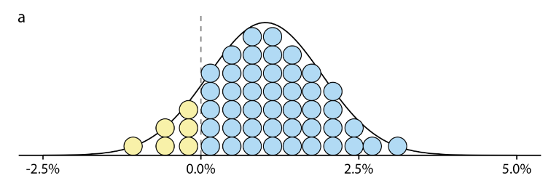
Uncertainty
  A quantile dotplot combines a discrete outcome visualization with a continuous distribution
  Takes advantage of the fact that humans are better at perceiving discrete units compared to areas

Slide 40

COFFEE TIME

Slide 41

Your projects (the “exam”)
Final assessment will be via submission of a homework project in which the student has analyzed their own data, tested hypotheses, and produced graphical output. The project must be submitted to an online repository with full documentation.
The grading is Bestått (approved) / Ikke bestått (not approved).
All submitted projects must have:
  Link to an online Github repository
  PDF with documentation and short write-up of project including examples of figures and justification of choices.

Slide 42
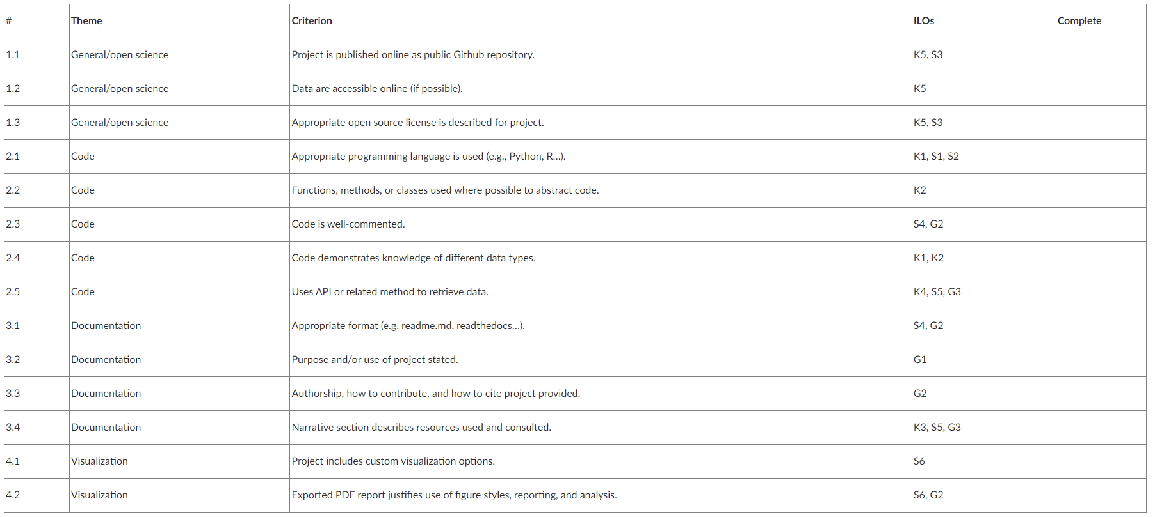
Your projects (the “exam”)

Slide 43
Timeline
Date | Activity
19 October | Project setup and version control in class
16 November | 3-5 min presentation of project (1 slide) in class
30 November | Peer feedback by cloning each other’s projects in class
14 December | Submit in Wiseflow

